Slide 1

The History of The Internet

Slide 2

What is the Internet??
According to Technopedia The internet is a globally connected network system facilitating worldwide communication and access to data resources through a vast collection of private, public, business, academic and government networks. It is governed by agencies like the Internet Assigned Numbers Authority (or IANA) that establish universal protocols . The terms internet and World Wide Web are often used interchangeably, but they are not exactly the same thing; the internet refers to the global communication system, including hardware and infrastructure, while the web is one of the services communicated over the internet.

Slide 3

Origin Of the Internet
No one person invented the internet. When networking technology was first developed, a number of scientists and engineers brought their research together to create the ARPANET. Later, other inventors’ creations paved the way for the web as we know it today.

Slide 4
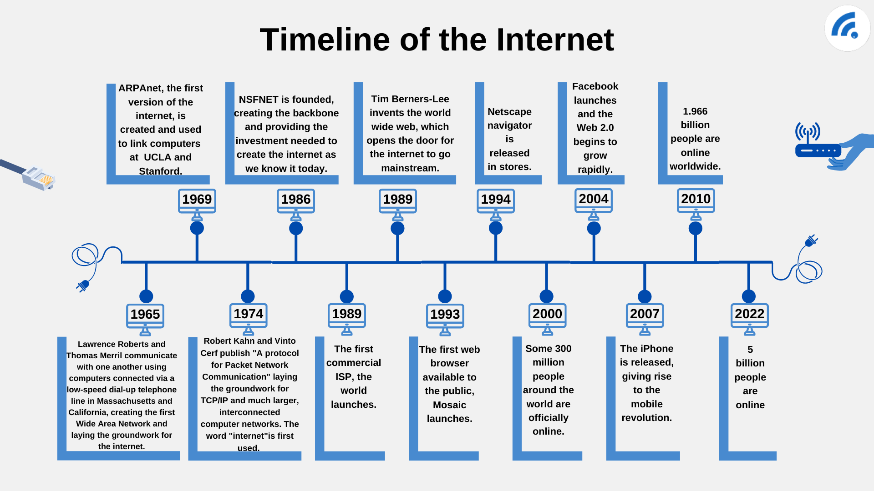
Timeline of the Internet

Slide 5
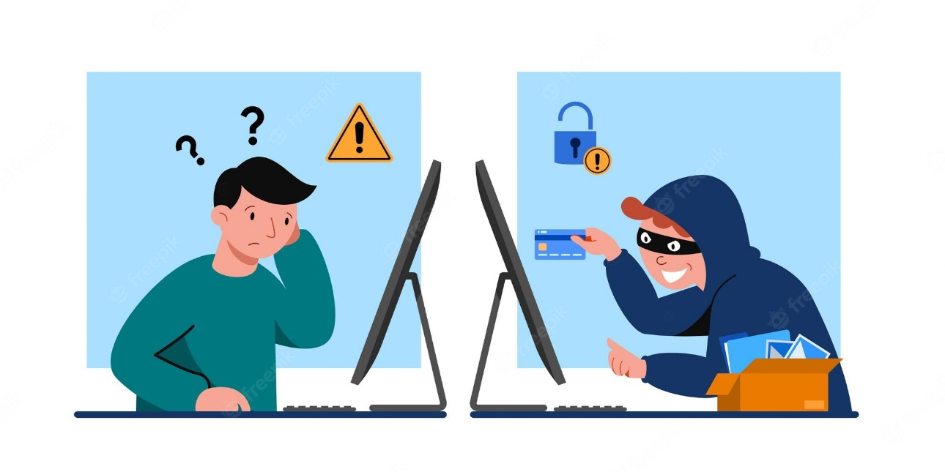
What is a Cybercrime ?
Cybercrime refers to any illegal activity carried out using computers or the internet. Cybercriminals ranging from individuals to organized crime groups to state-sponsored factions — use techniques like phishing, social engineering, and all kinds of malware as part of their cyber attacks.

Slide 6

The History of Cybercrime 1971
The first example of a computer virus was a program called Creeper. It was written by Bob Thomas and designed to travel between Tenex terminals
on the ARPANET, the internet’s forerunner, and displayed the message
‘I’m the Creeper: Catch me if you can’.

Slide 7

Data Encryption 1977
The Data Encryption Standard was published in 1977 after being developed by IBM in the early to mid-1970s. The NSA-approved cryptography method brought encryption previously only used by the military to the wider world of computing.

Slide 8
The most Common Types of Cybercrimes
Phishing
Ransomware Attack
Intellectual Property Theft
Social engineering
Software piracy
Email and internet fraud
industrial espionage

Slide 9
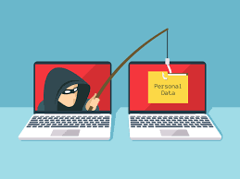
Phishing
Phishing is a type of social engineering attack often used to steal user data, including login credentials and credit card numbers. It occurs when an attacker, masquerading as a trusted entity, dupes a victim into opening an email, instant message, or text message. The recipient is then tricked into clicking a malicious link, which can lead to the installation of malware, the freezing of the system as part of a ransomware attack or the revealing of sensitive information

Slide 10

Ransomware Attack
Ransomware is a type of malicious software (malware) that threatens to publish or blocks access to data or a computer system, usually by encrypting it, until the victim pays a ransom fee to the attacker

Slide 11

Intellectual property theft
Intellectual property theft (IP theft) refers to the robbing of people or companies of their ideas, inventions, and creative expressions (i.e., their IP). There are four main types of IP, including trade secrets, trademarks, copyrights, and patents.

Slide 12

Social engineering
Social engineering is the term used for a broad range of malicious activities accomplished through human interactions. It uses psychological manipulation to trick users into making security mistakes or giving away sensitive information.

Slide 13

Software piracy
Software piracy is the illegal copying, distribution, or use of software. It is such a profitable "business" that it has caught the attention of organized crime groups in a number of countries. According to the Business Software Alliance (BSA), about 36% of all software in current use is stolen. Software piracy causes significant lost revenue for publishers, which in turn results in higher prices for the consumer.

Slide 14

Email and internet fraud
Internet fraud involves using online services and software with access to the internet to defraud or take advantage of victims. The term "internet fraud" generally covers cybercrime activity that takes place over the internet or on email designed to scam the money of individuals.

Slide 15
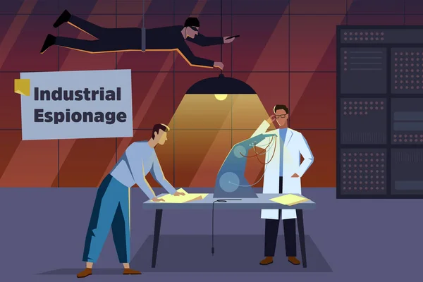
Industrial espionage
Industrial espionage is the illegal and unethical theft of business trade secrets for use by a competitor to achieve a competitive advantage.

